Slide 1
Building Rehabilitation
Explain why there are different requirements for new and existing buildings
Distinguish between repair, renovation, modification, reconstruction, addition, and change in occupancy
Determine when chapter 43 applies

Slide 2
Historic Fire
First Interstate Bank

Slide 3
Existing Buildings
Once approved buildings stays approved
  Rare cases of retroactive requirements
Odd chapters
  Work done to building
  Change of occupancy
Not always practical to meet all requirements

Slide 4
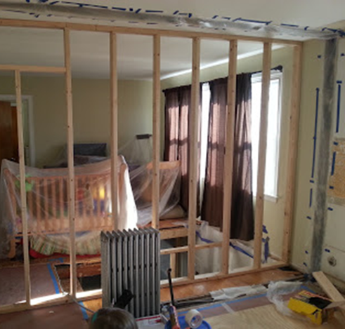
Types of Rehabilitation Work
Repair
Renovation
Modification
Reconstruction
Change of use or occupancy classification
Addition

Slide 5
Chapter 4
Existing buildings
  Time for compliance: limited but reasonable, expenditure, disruption, degree of hazard
  Additions same as new construction
  Renovations as nearly as practical to new construction
Conditions for occupancy
  Plan of correction
  Occupancy classification does not change
  No serious life safety hazard

Slide 6
Chapter 4
Construction, repair, and improvement operations
  Must have egress routes
Changes of occupancy
Maintenance and testing
  Responsible persons
  Applicable standards

Slide 7
Reconstruction
Typically, 50% of building reconstructed = upgrade everywhere
Illumination and emergency lighting at level of new construction
Supply smoke alarms in residential areas
Sprinklers and standpipes throughout in some cases

Slide 8
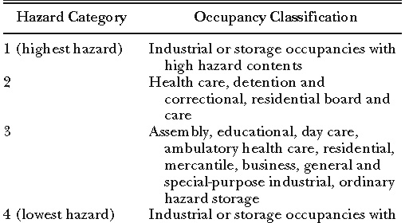
Change of Occupancy

Slide 9
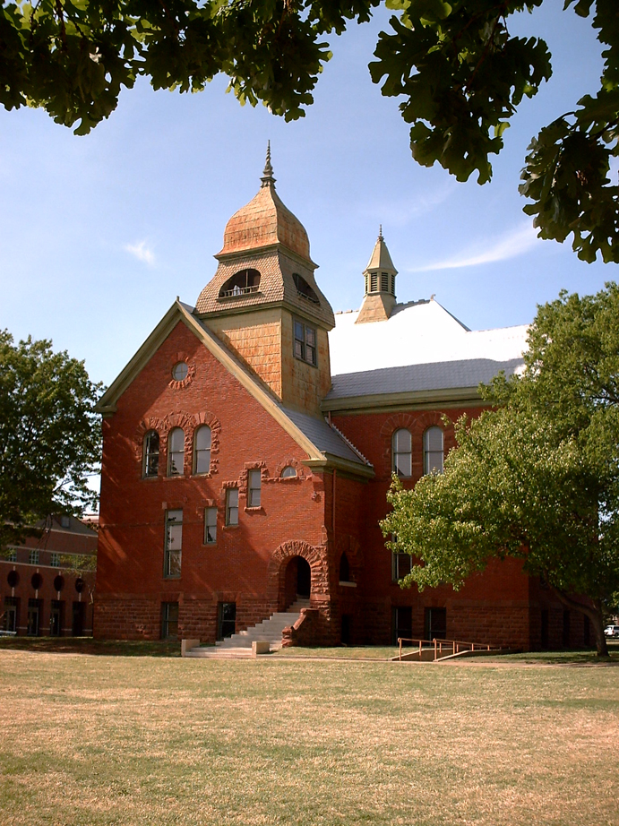
Historic Buildings
Code recognize that buildings are unlike others
Will usually require PBD
Can fix with like
Can leave means of egress with AHJ consent

